Slide 1


Internet of Things
by SHALOMSHAN SELVAKUMAR
B.Sc. (Hons) Computer Science & Software Engineering
Entrepreneur | Software Engineer | Researcher
Technology & Social Innovator

Slide 2
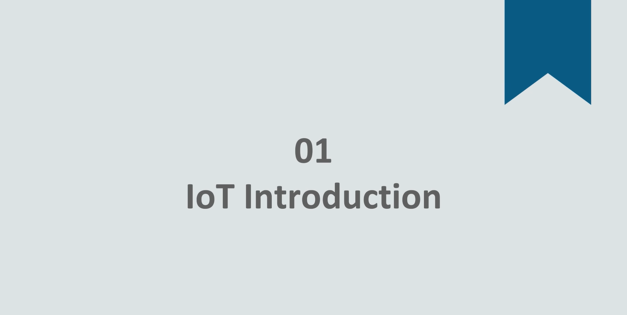

Slide 3
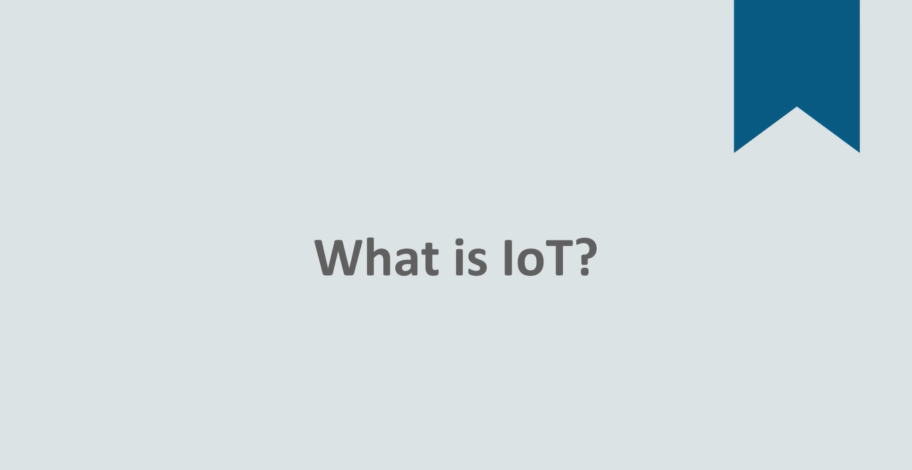

Slide 4
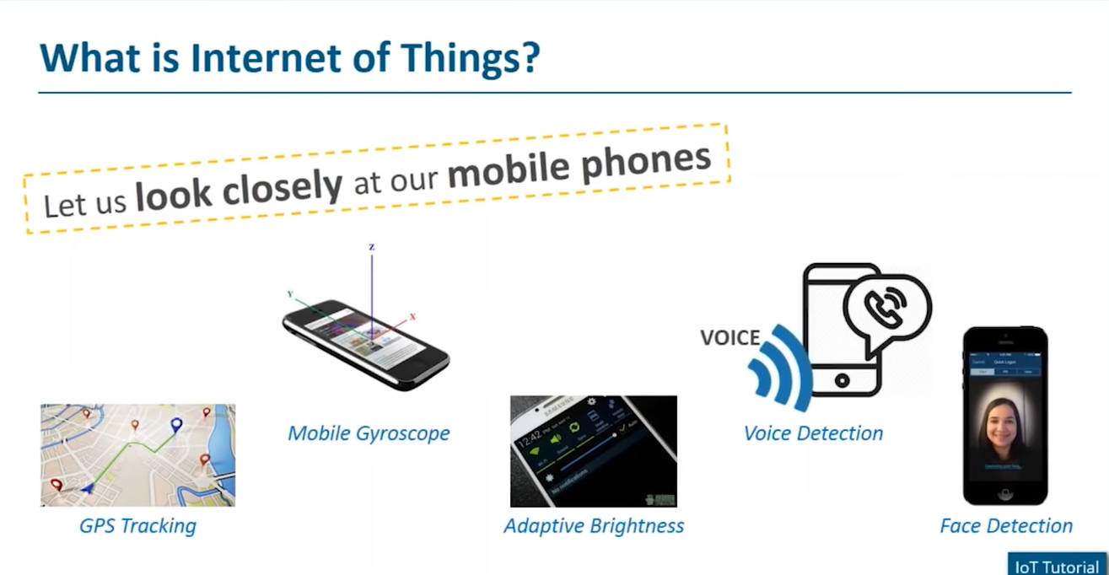
Notes:
What is internet of things lets look at an example of a mobile phones forest. Our mobile phone has gps tracking it also has mobile gyroscope you have adaptive brightness, based on the light falling on it you have voice recognition. And you also have face detection is coming face detection. That are coming pre built and most of these have a common interaction between them of these features. In itself being interacting with each other. My brightness could be adjusted or based on the direction. My phone is being held the brightness in itself so there are a lot of features come together to bring in a better system that they can provide individuallyas such that’s.

Slide 5
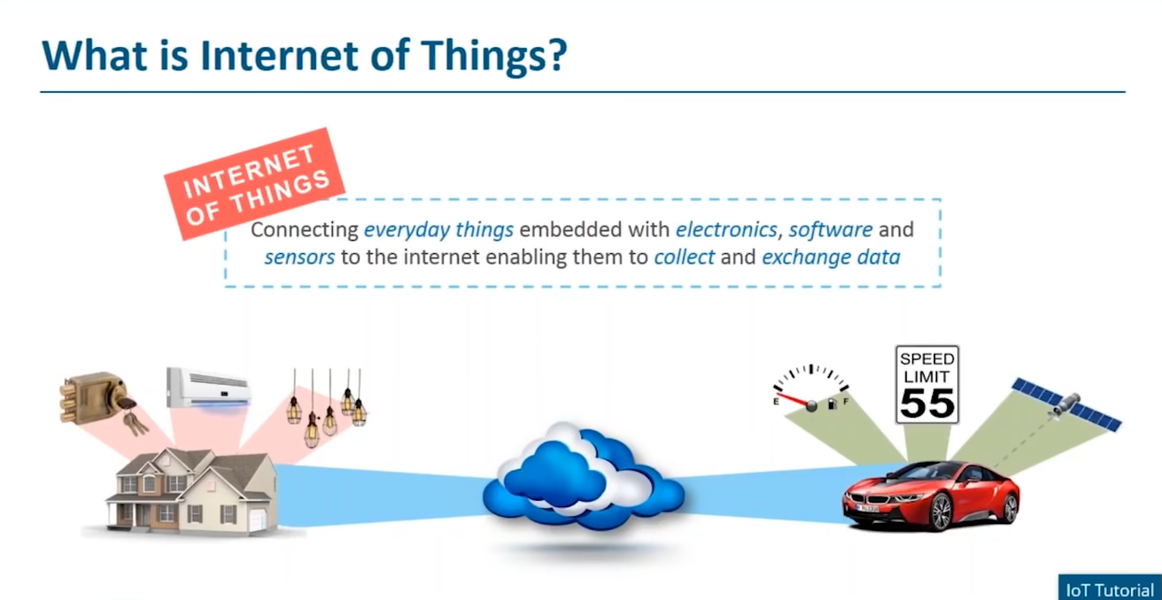
Notes:
What internet of things is it basically is platform which are embedded with either electronics software and this in turn enables us to collect as well as exchange between these things. Now when I say things it can be anything and nothing, and I can connect these things I can connect my AC. And all this can be managed on the same platform so I can also connect my car to this. I can keep a track of my speed limit. Of the car as well. Where all of these are connected wouldn’t it be great to of the AC on and set a cool temperature at my home by the time I reach back from office that knows my preference and that keeps track of where I am and where I’m going to then it can also identify from work back to hope and my preference suggest if there was an easy temperature of about 22 or 23 degree centigrade and this is something. Mow this is just one of the example now home it would be grade. My home system should be aware that I have come home and should unlock all the doors if my mobile and my home devices are connected onto the same platform based on the location of my mobile. That I am at my hope so it will automatically unlock the door and let me come in as well. There are something that are already happening what need to understand is which can do a lot individually wouldn’t it be great if I can collaborate this complaint with my system of different components and build up at a system. This is what internet of things is helping us to okay. You provide a platform to which all these are connected so internet becomes the medium through which you're connecting all these components were things to a platform.

Slide 6
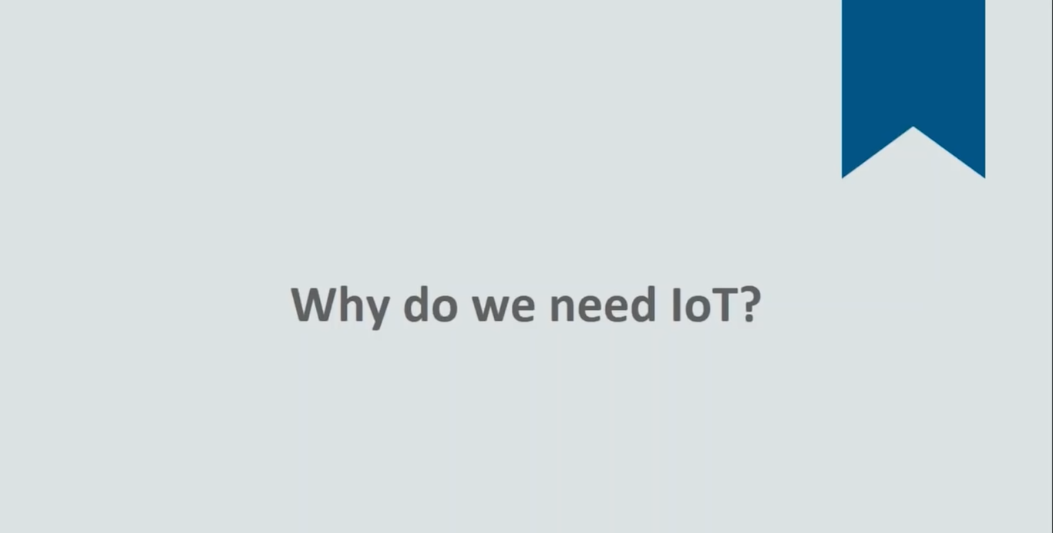
Notes:
Why do we need IoT?

Slide 7
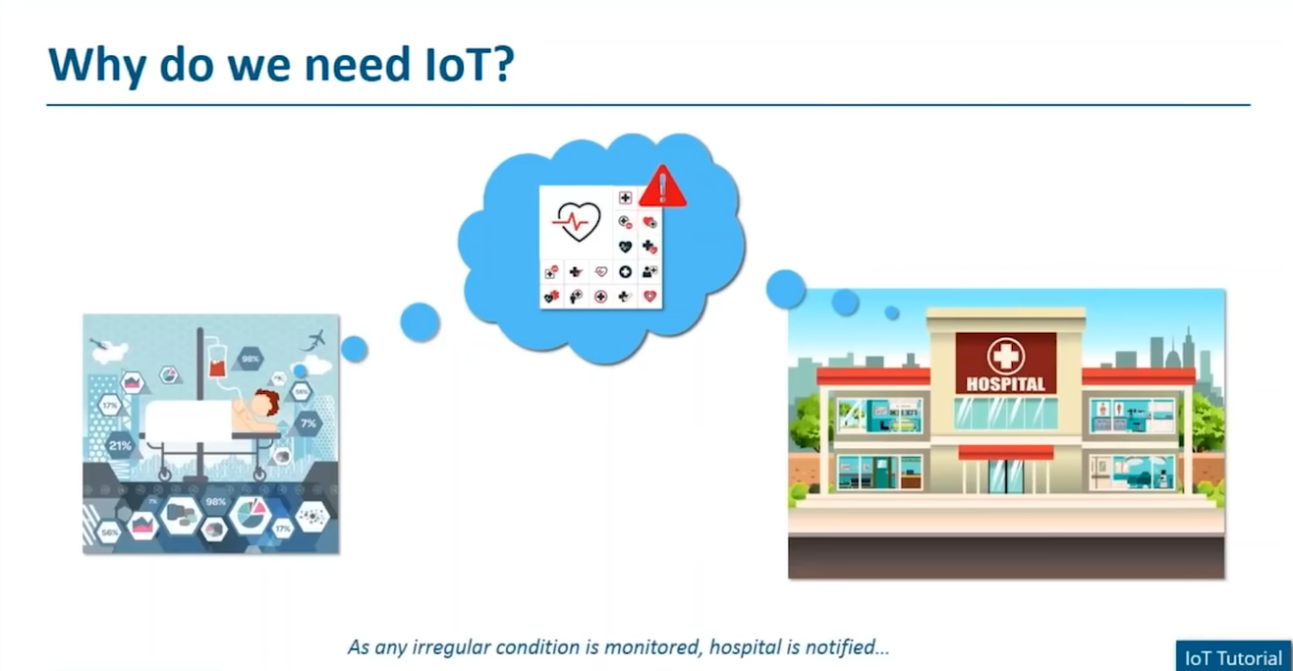
Notes:
This is a patient at home He’s on constant life support wearing. To a health monitoring system present on the cloud. With respect to his health. Let’s say there’s some irregularity with his heartbeat there’s some fluid being developed or so far now what? Offenses since the system on the cloud is connected this information would get passed on that the would get the complete details and the important information with respect we made it aware with respect to what issue exactly is the patient facing as well as enabled immediately to bring the patient back to the hospital as well. Once the patient has been picked up ….

Slide 8
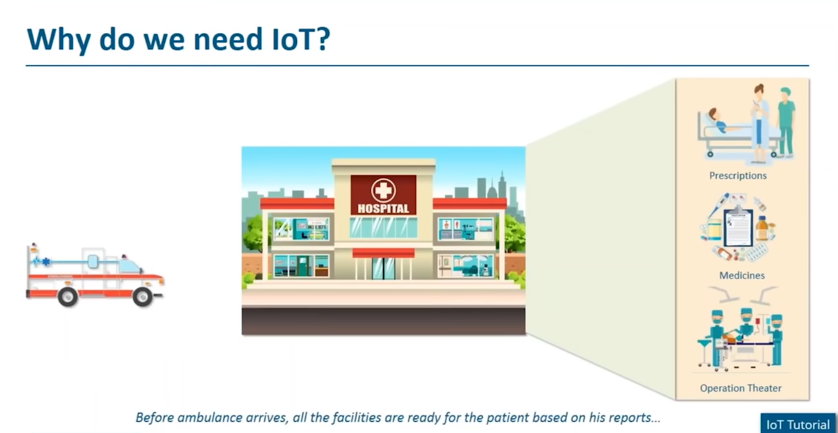
Notes:
And brought back to the hospital there could be prescriptions. They could also be an operating theater made ready there’d be doctors on standby who have the complete details so this in turn brings in a lot of transparency and reduces a lot of effort and time involved with respect to this same things. There has to be someone wandering this patients health if there’s a fluctuation they need to call the hospital they and meanwhile once the ambulance is here then again there needs to be a lot of checkups because the doctors are not fully aware again. Abd this in turn leads a lot of delay as well in certain emergency cases As such, if a system can do this, then this extractely What we made to definitely move forward to now. Internet.

Slide 9
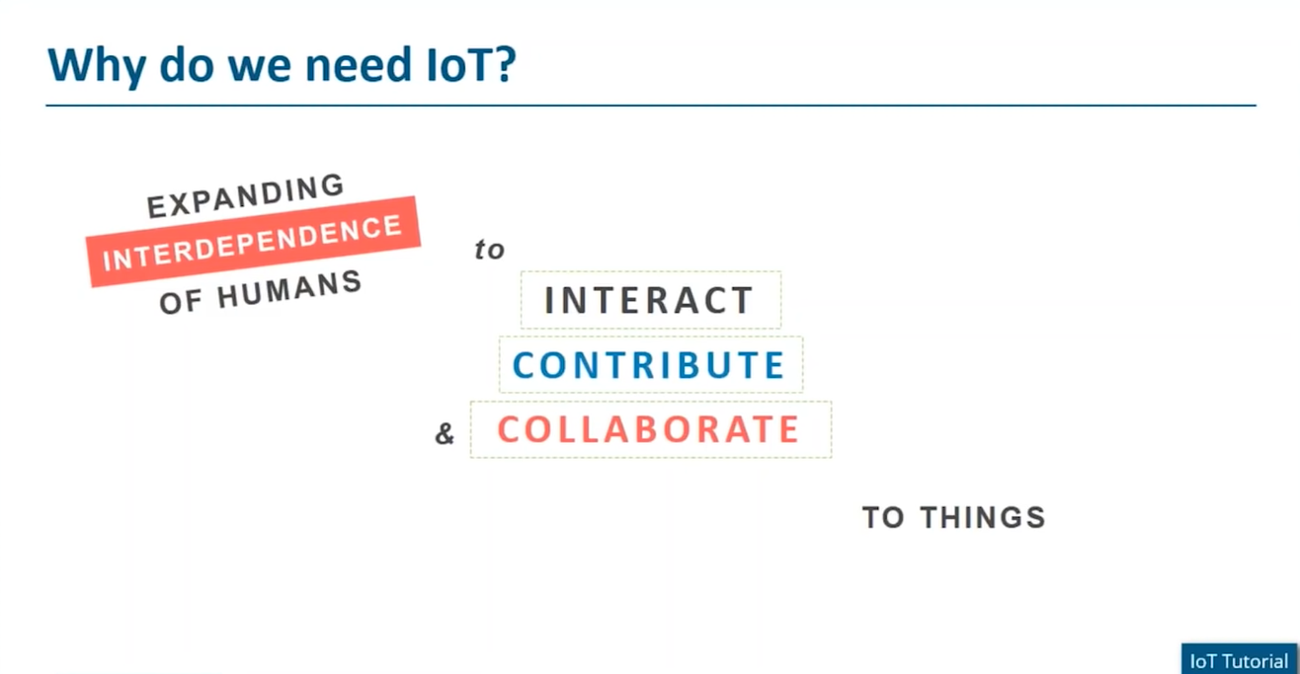
Notes:
Internet of Things basically is expanding the interdependence of humans to interact contribute what do I mean by interdependence of human see how we depend on each other like if you’re not clear you would reach back to me. Okay this becomes an interdependence between us when you’re not here you’re coming back to me if there’s something that you can do for me, we all are interdependent on each other for something this interdependence to interact collaborate and contribute with respect to the different things around us. Then we would be building a proper internet this would be a much more safer secure effortless and time saving environment into existence moving forward.

Slide 10


Slide 11
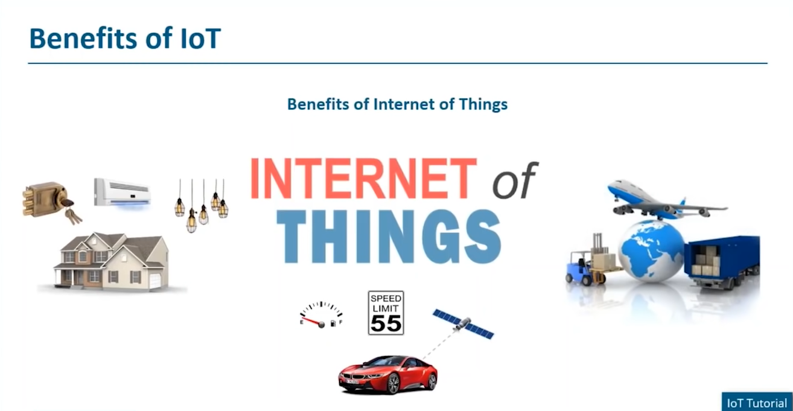
Notes:
Let’s talk about the various benefits of internet of things of having an internet of things platform would that you could efficiently utilize the resources.

Slide 12
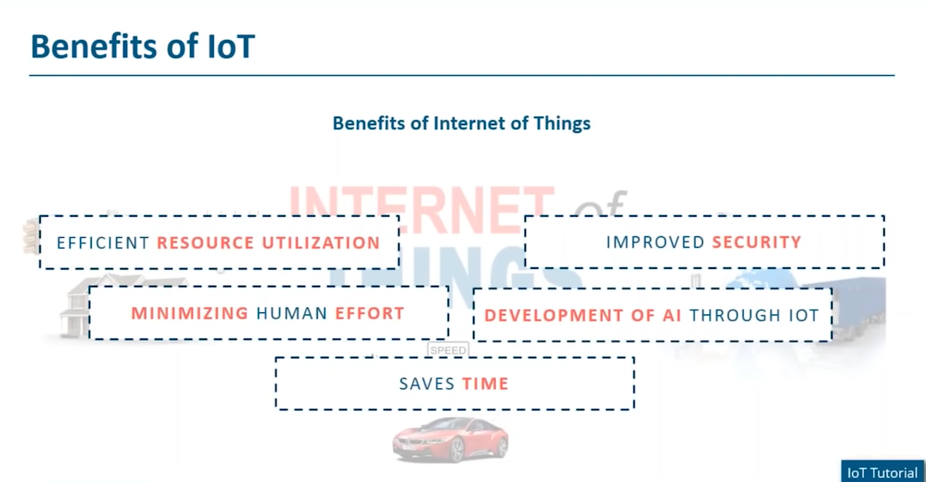
Notes:
If I have an smart system which can interact if it has enough understanding I’m quit sure the usage of the resources available will be more efficient as well

Slide 13


Slide 14
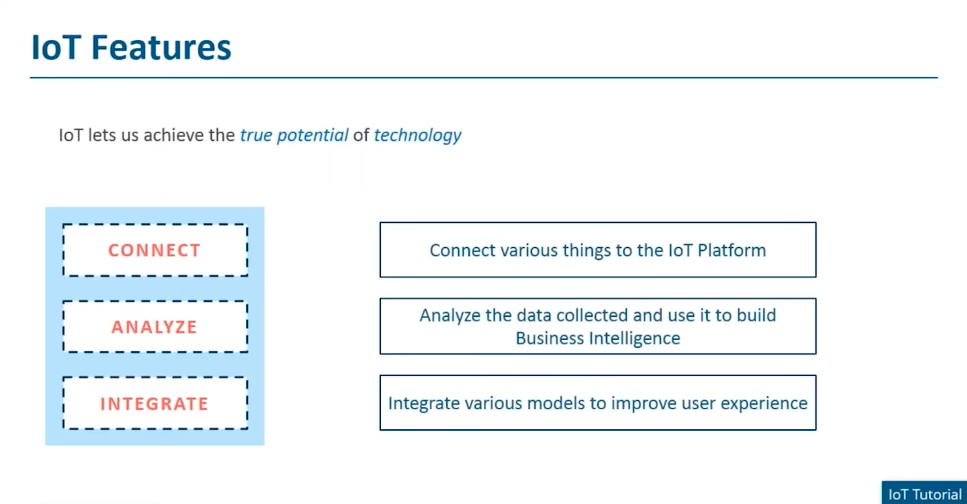

Slide 15
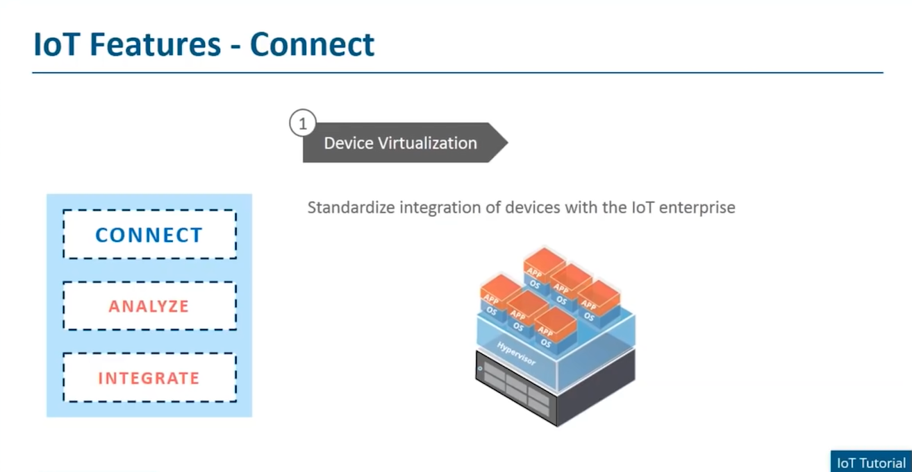

Slide 16
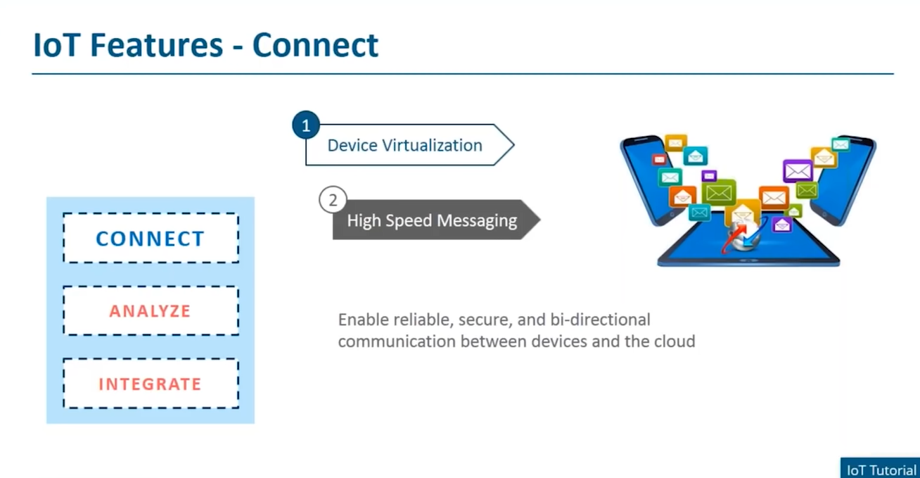

Slide 17
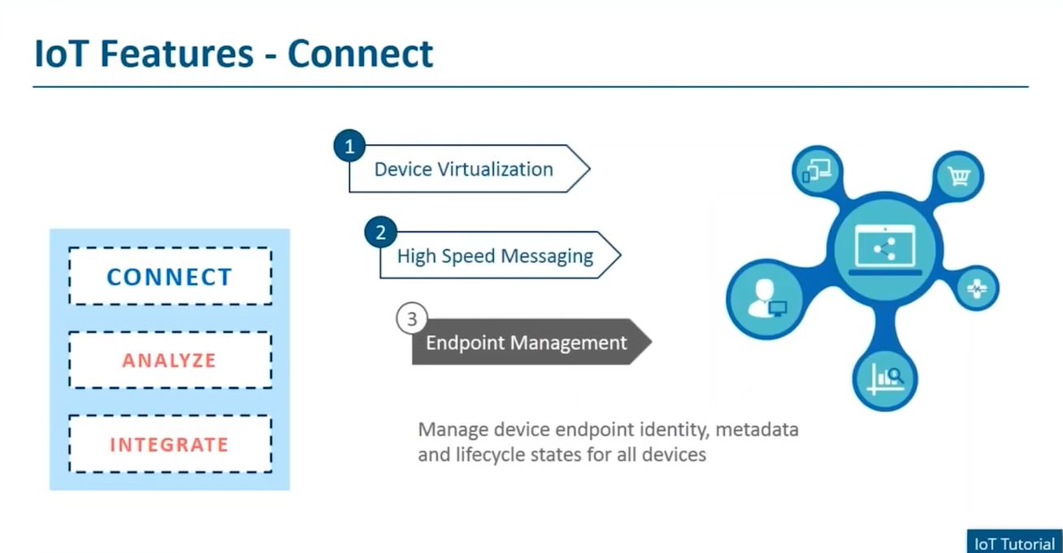

Slide 18
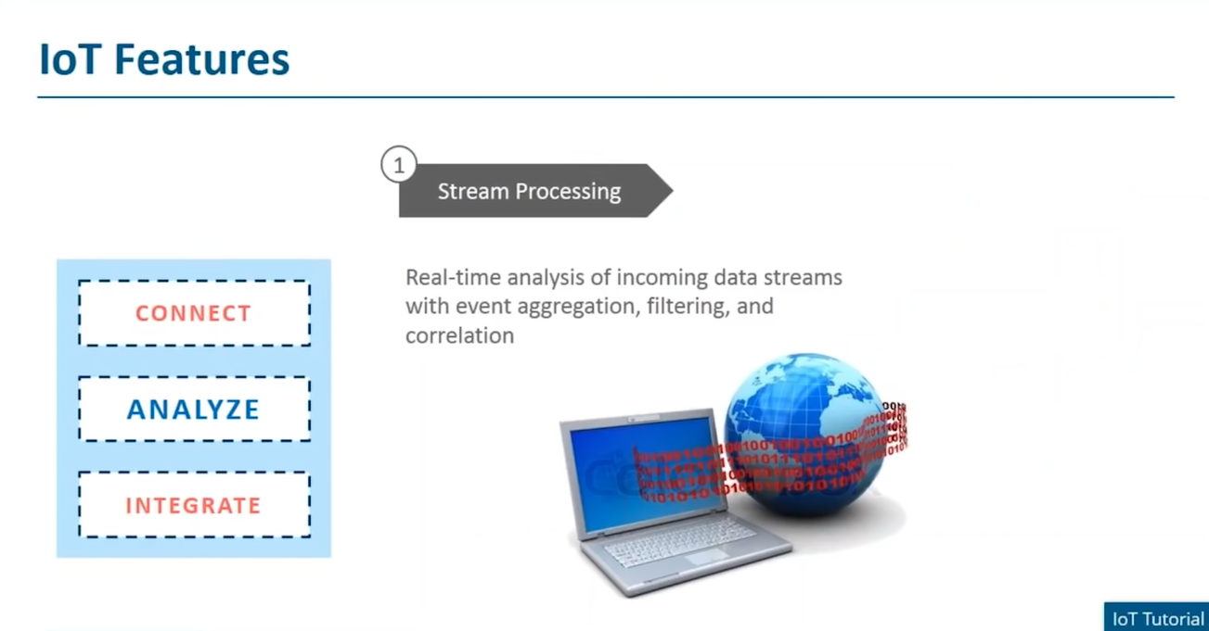

Slide 19
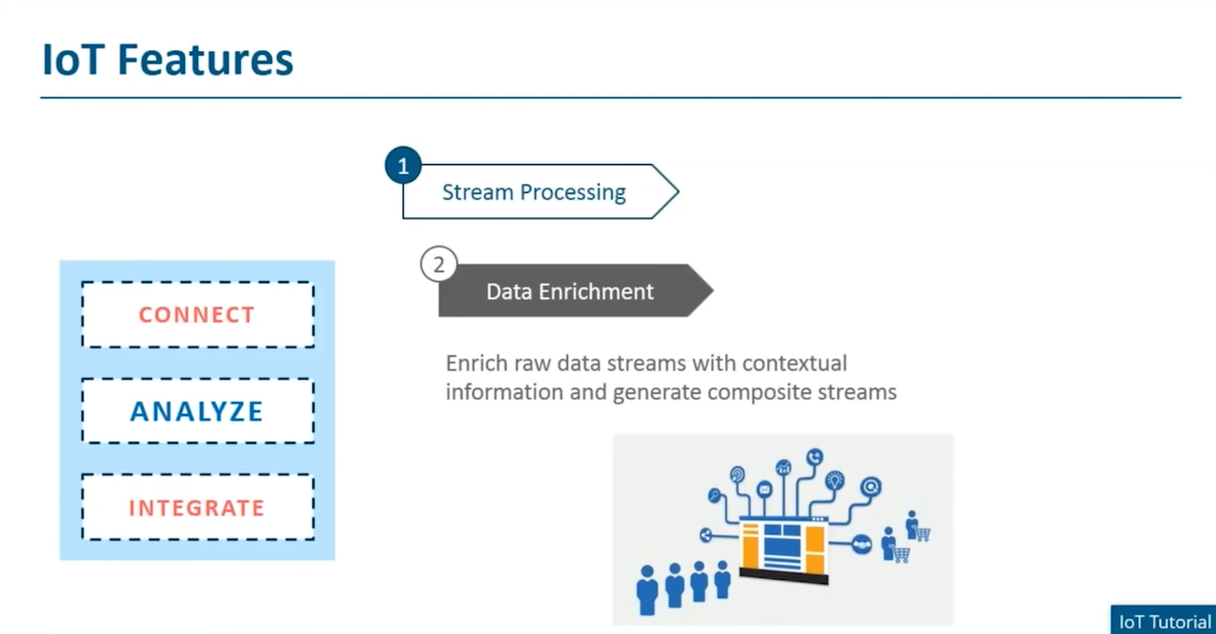

Slide 20
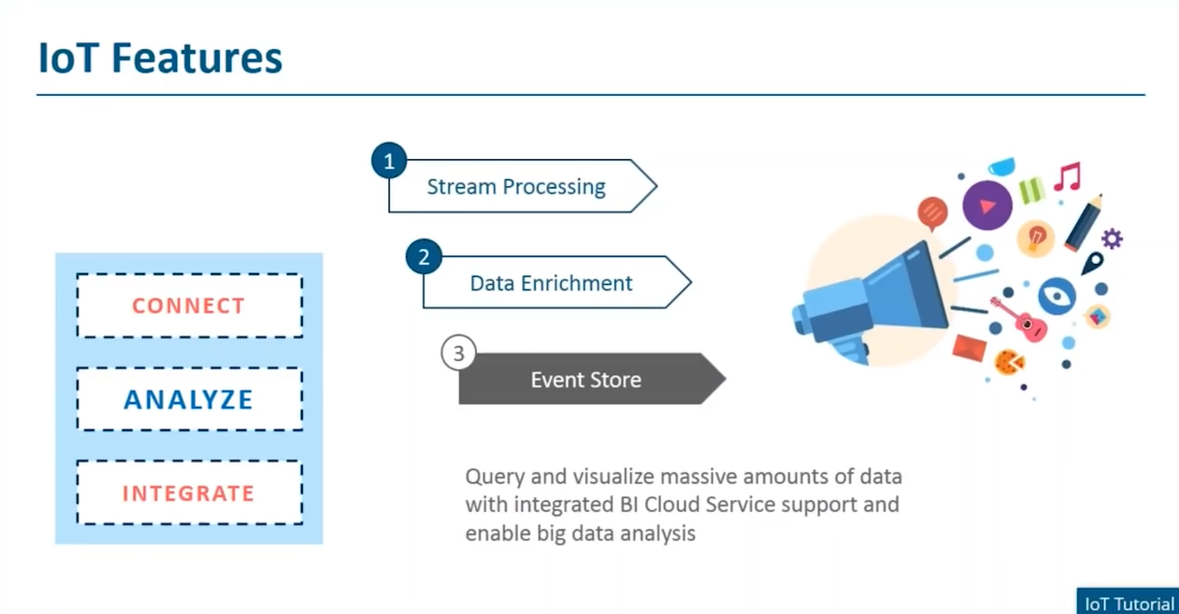

Slide 21
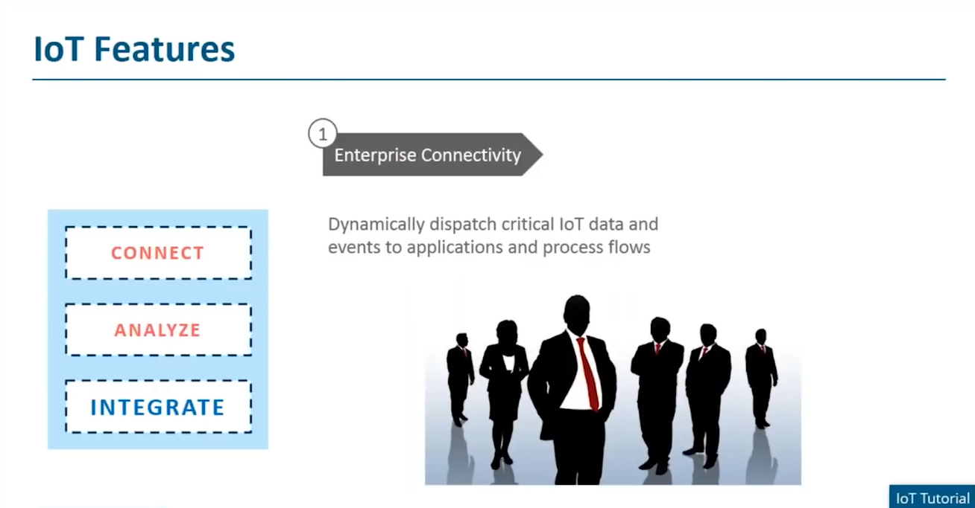

Slide 22
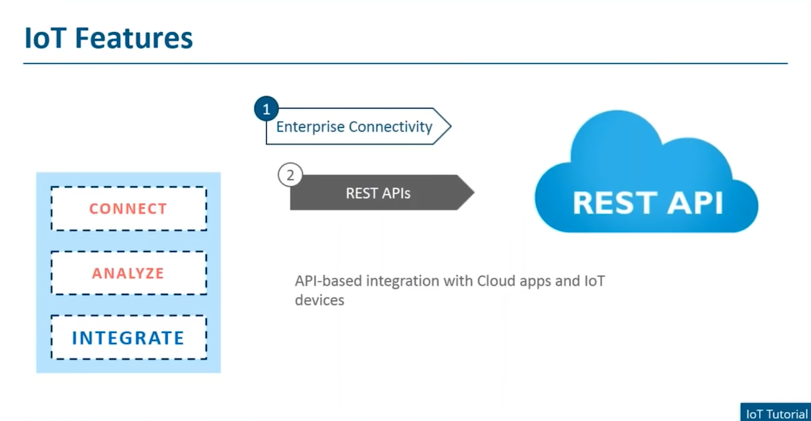

Slide 23
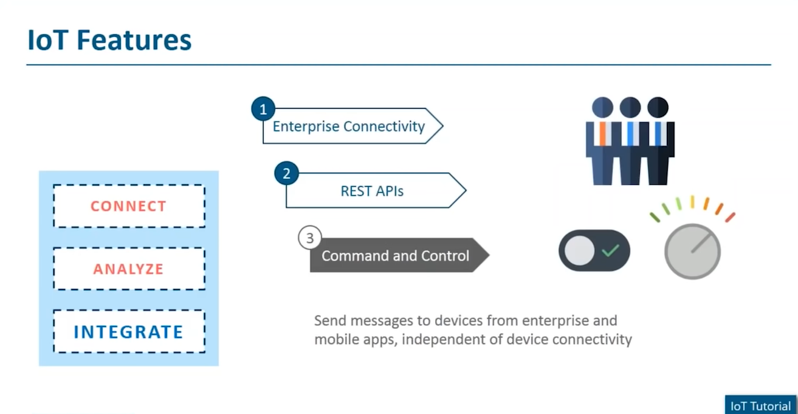

Slide 24


